Slide 1

Linear lists and their applications
Note: Please turn off your microphone and camera.
Teacher Gao's Algorithm Competition Training Camp

Slide 2
linear list
Characteristics of linear structures
There exists a unique data element referred to as the "first".
There exists a unique data element referred to as the "last".
Except for the first one, each data element has only one predecessor.
Except for the last one, each data element has only one successor.
Storage structure of linear lists
Store in sequence
The data element types must be the same, but the stored data can be different.
Linear lists are classified according to their storage structure.
Sequential list
Linked list

Slide 3

Sequential list
Store sequentially in a set of contiguous memory locations.
It's an "array"
Features:
The complexity of random access, retrieval, and assignment is O(n log n).$O(1)$
Insertion involves shifting the element to the right to create space before assigning a value; the complexity is O(n log n).$O(n)$
Deletion, followed by shifting the deleted element to fill the gap, has a time complexity of O(n log n).$O(n)$

Slide 4
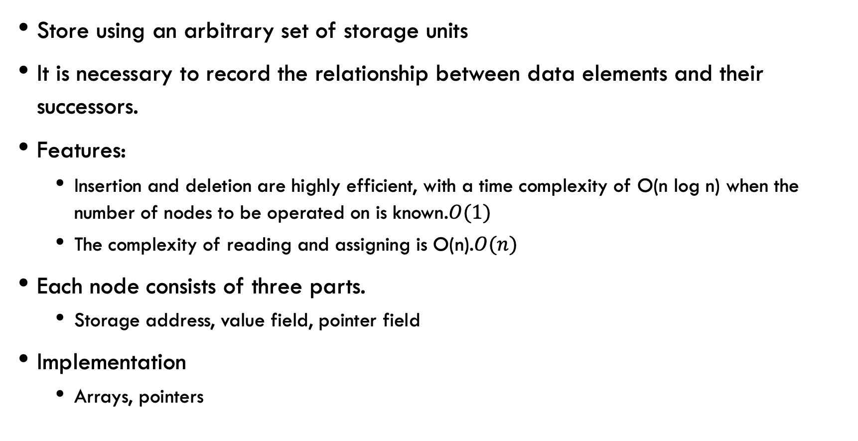
Singly linked list
Store using an arbitrary set of storage units
It is necessary to record the relationship between data elements and their successors.
Features:
Insertion and deletion are highly efficient, with a time complexity of O(n log n) when the number of nodes to be operated on is known.$O(1)$
The complexity of reading and assigning is O(n).$O(n)$
Each node consists of three parts.
Storage address, value field, pointer field
Implementation
Arrays, pointers

Slide 5
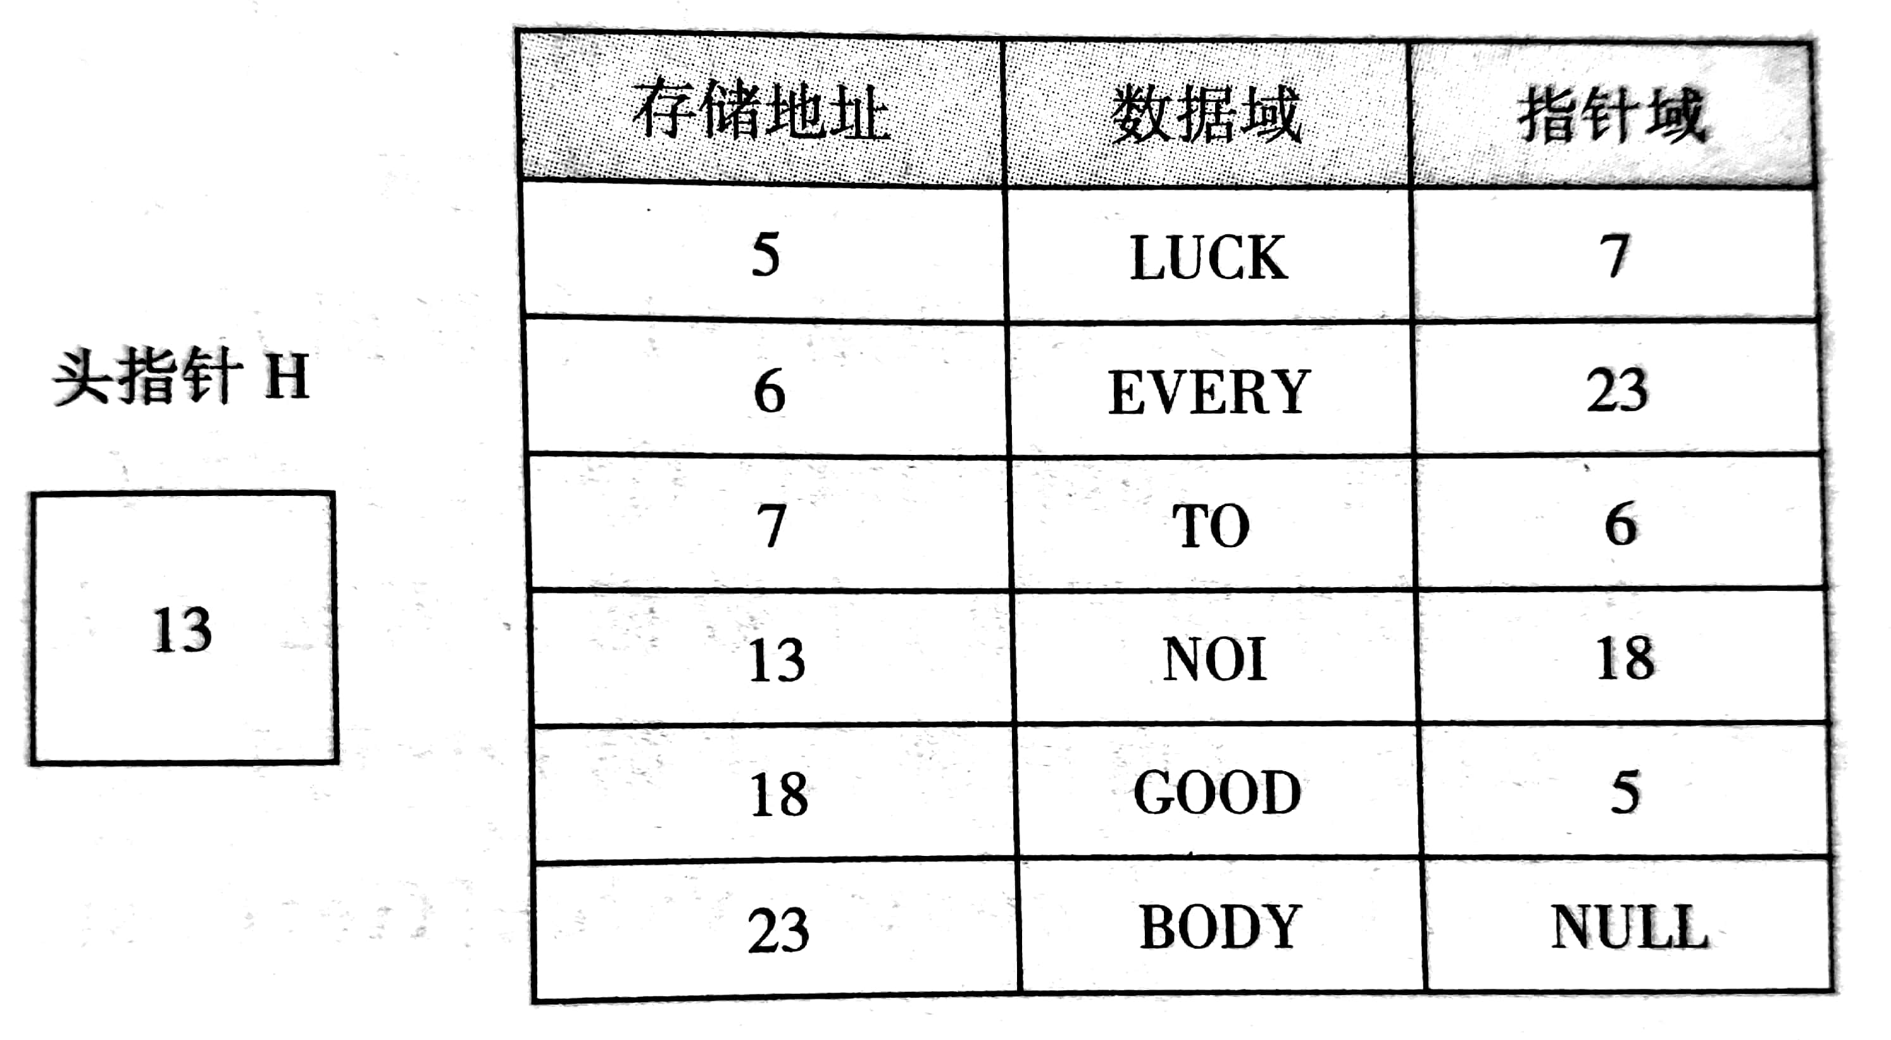
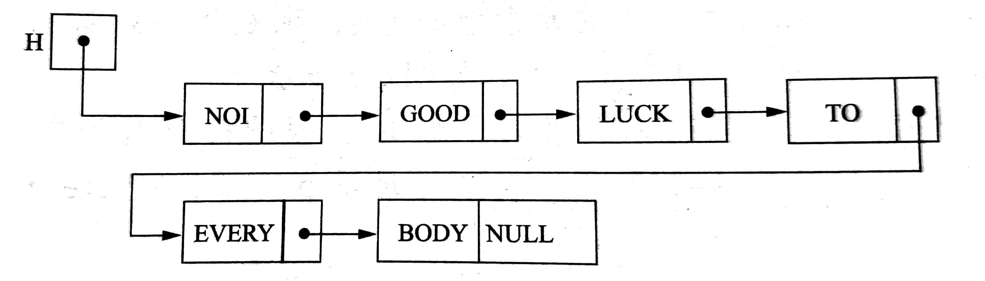
Singly linked list

Slide 6
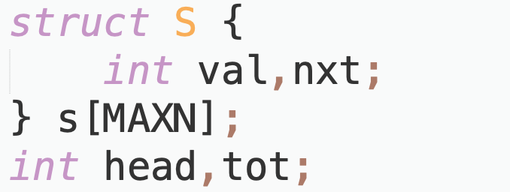
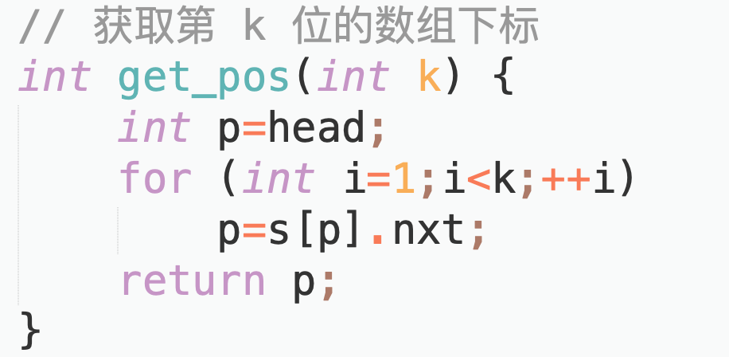
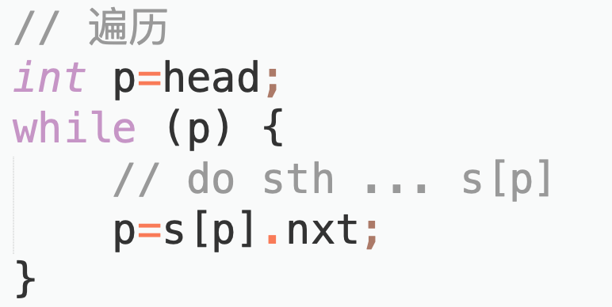
Implement a singly linked list using an array.

Slide 7
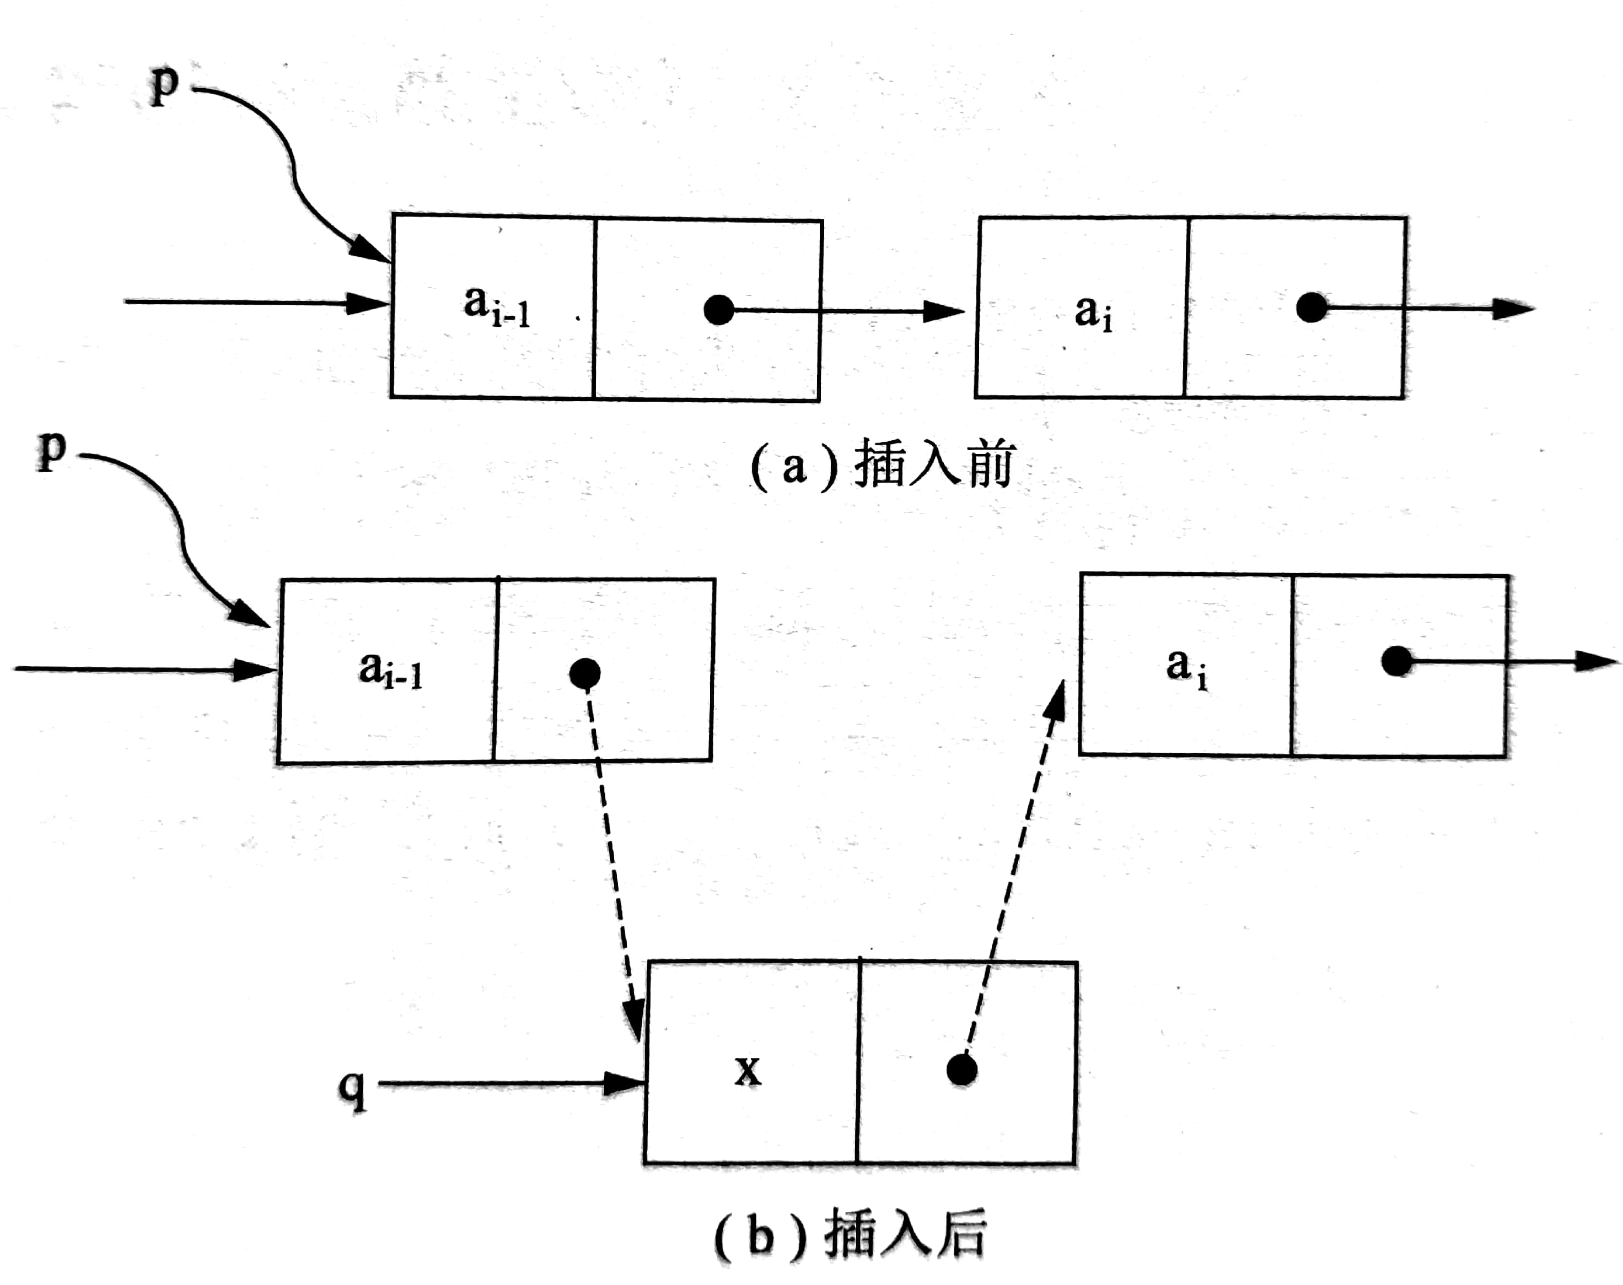
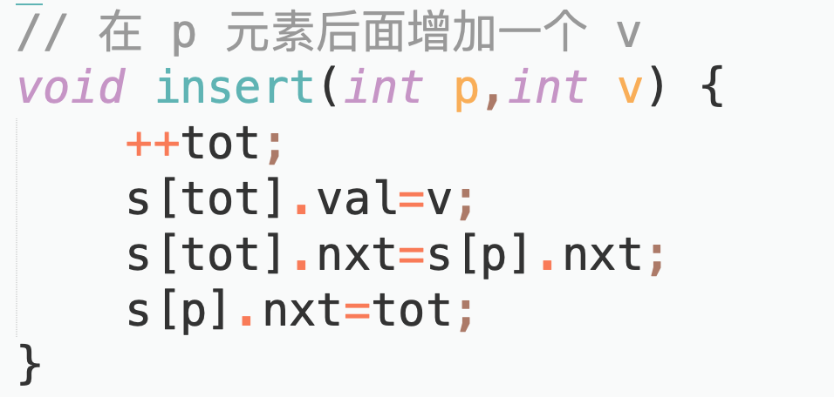
insert

Slide 8
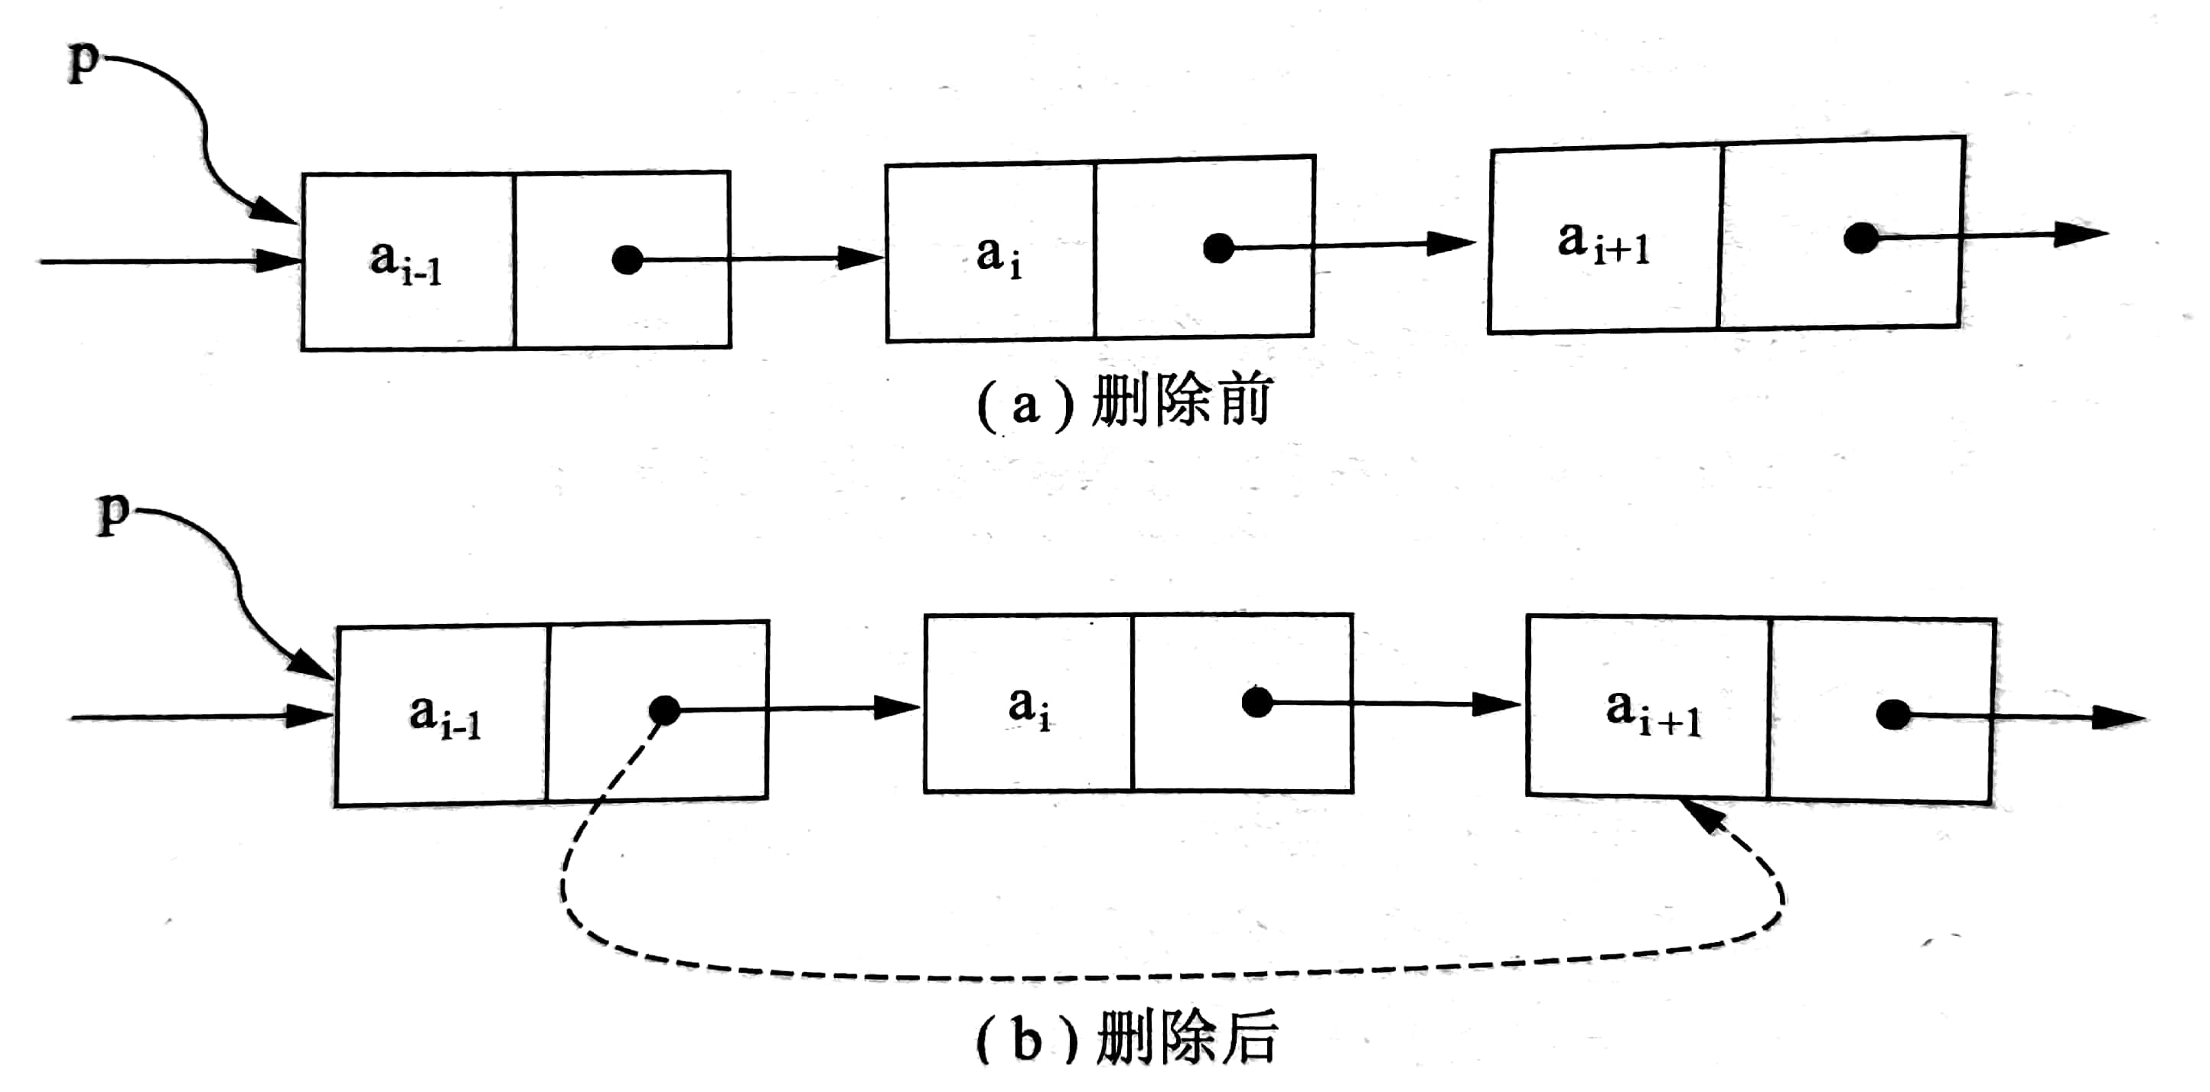
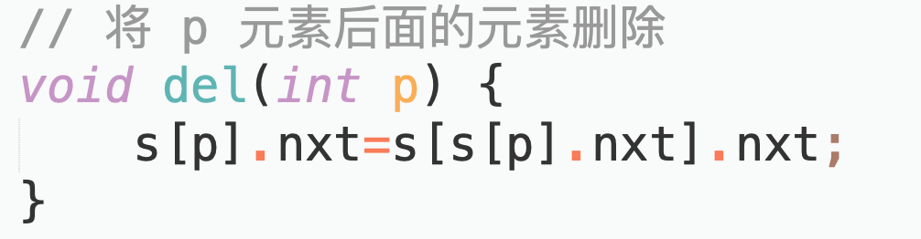
delete

Slide 9
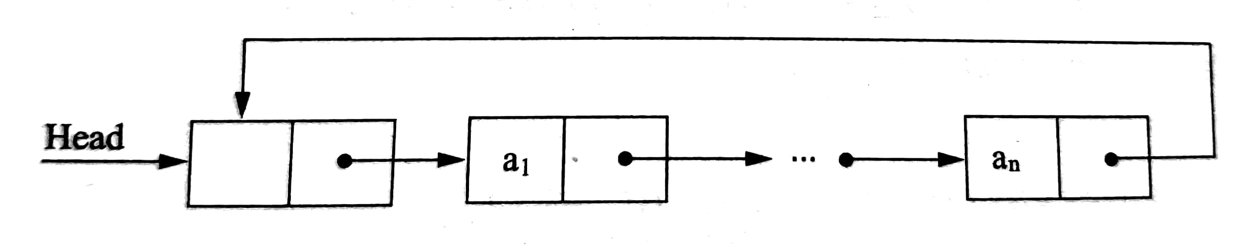
Circular linked list
The pointer of the last node in the table points to the head node, and the entire chain forms a loop.

Slide 10
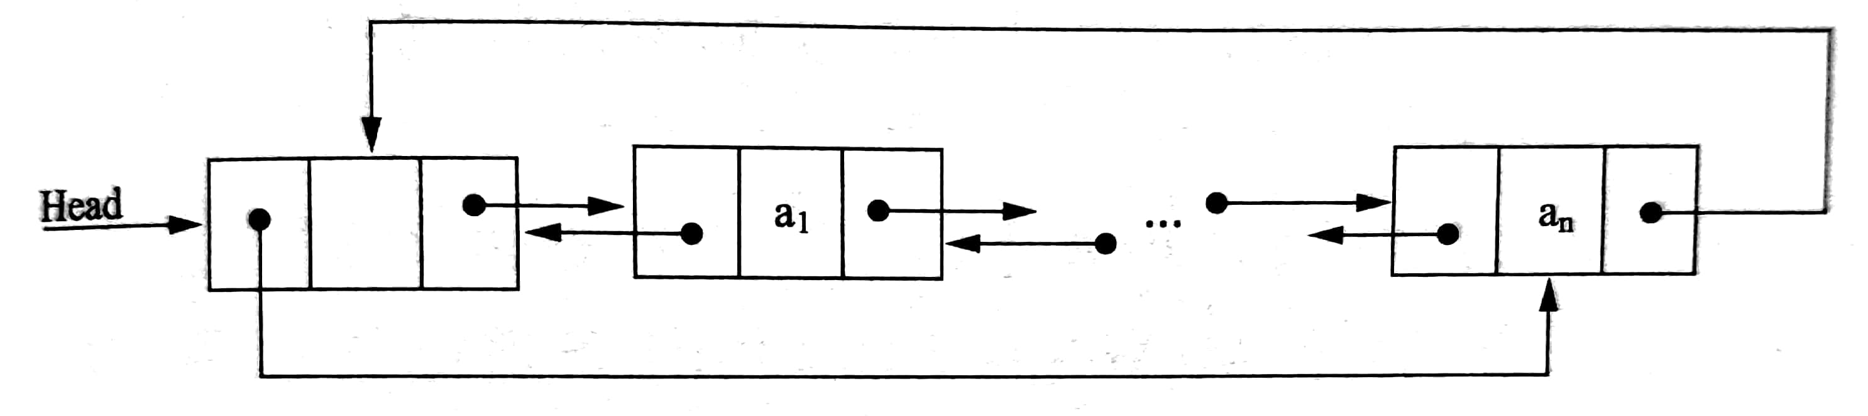
Doubly linked list
A linked list node has two pointer fields, one pointing to the direct successor and the other pointing to the direct predecessor.
There are also doubly linked circular lists.

Slide 11
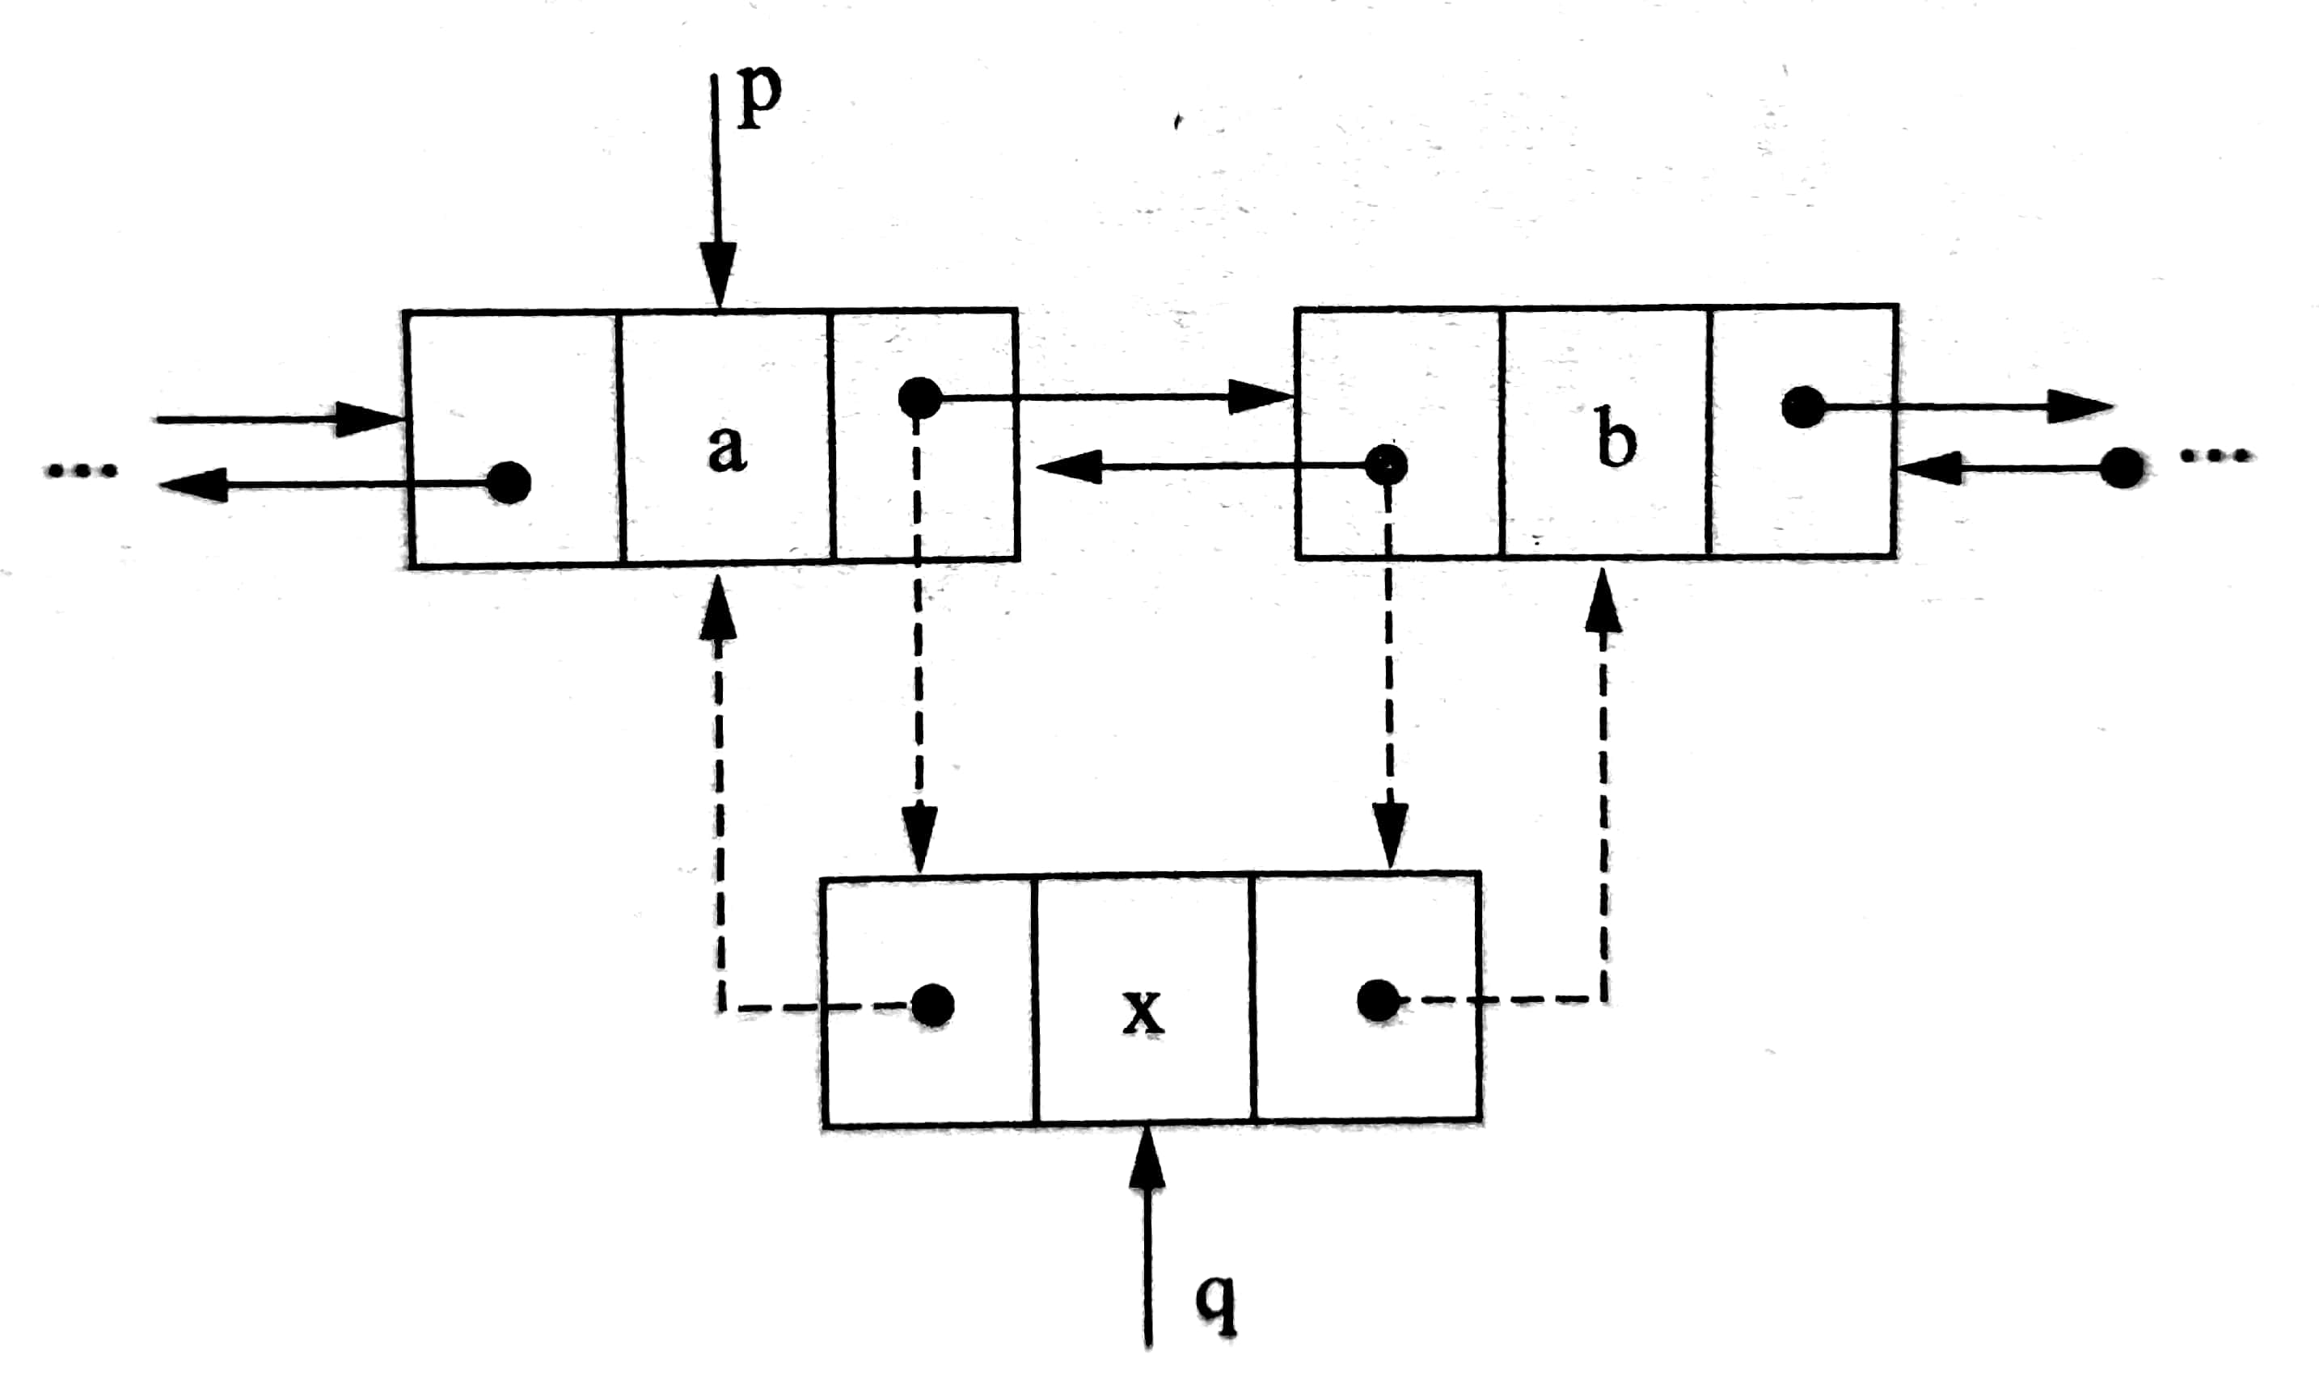
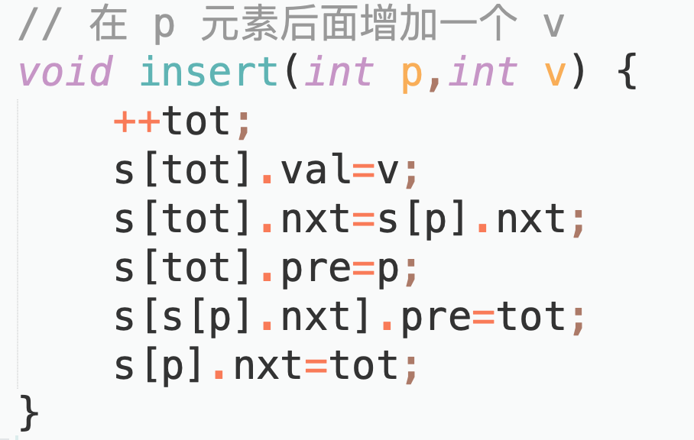
Insertion of a doubly linked list

Slide 12
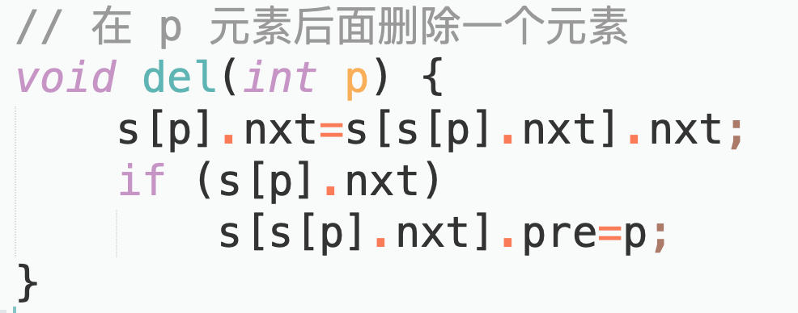
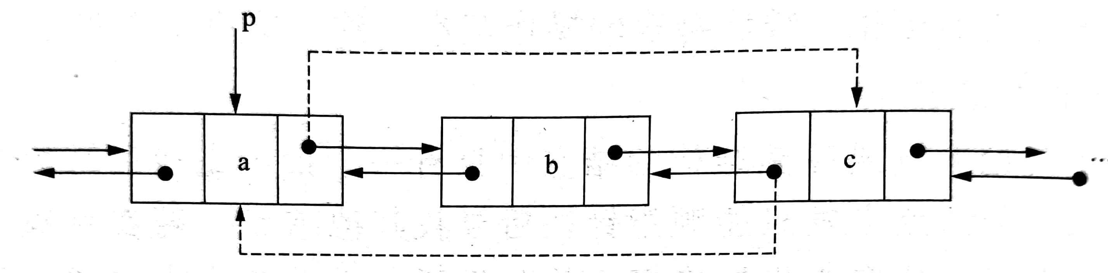
Deletion of a doubly linked list

Slide 13
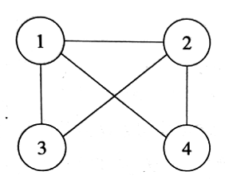

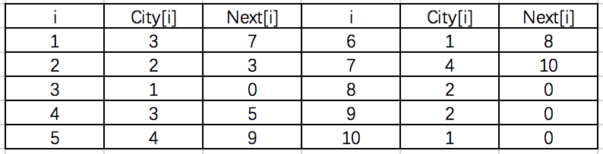

Applications of linear lists
$N(N≤100000)$ One point, $M(M≤5000000)$How to store a graph with edges?

Slide 14
Delete an element from an array (using a linked list).
Find the number in the array that is equal to
Method: Traverse the singly linked list sequentially and compare...

Slide 15
Compile student information (using a linked list).
Input information and output in reverse order
Method 1: After inputting the data, reverse the singly linked list and then output the result.
Method 2: Insert the data at the head of the linked list each time, and then output the data sequentially.

Slide 16
Josephus Problem (Solved using linked lists)
Every time you count to M , one person is eliminated. Who is left in the end?
Method: Circularize the linked list, move M steps each time, and then delete the current element.

Slide 17
Stacks and applications
Note: Please turn off your microphone and camera.
Mr. Gao's Algorithm
Competition Training Camp

Slide 18
stacks
Linear lists that restrict insertion or deletion operations to only the end of the list.
First In Last Out (FILO)
Main operations
is_empty, is_full, size
push
pop
Implementation
Sequential list (array) sta[m]
stack pointer top
pop
top
a_{n}
…
a₂
a₁
push
bottom

Slide 19
stacks
₁
₂
₁
₁
top = 2
top = 1
top = 1
top = 0
(a) initialise
(b) push
(c) push
(d) pop 2
₃
₁
₁
top = 2
top = 1
top = 0
(e) push
(f) pop 3
(g) pop 1

Slide 20
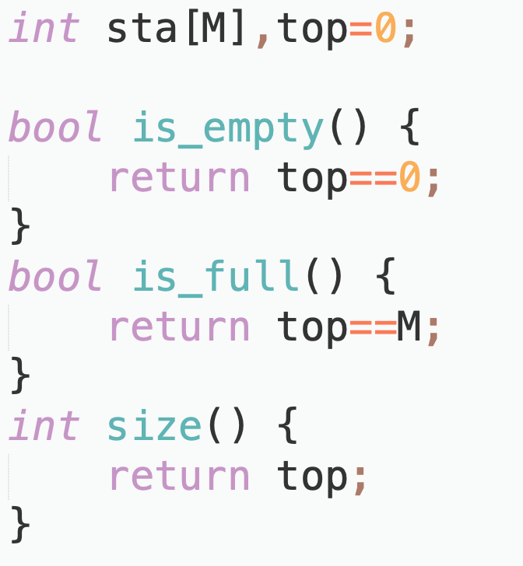
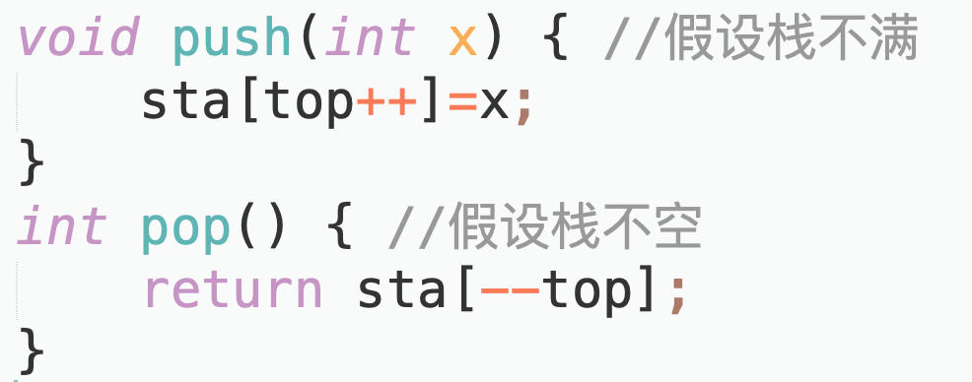
Stacks code implementation
//Not full
//Not empty

Slide 21
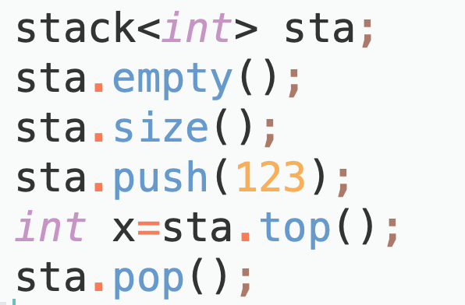
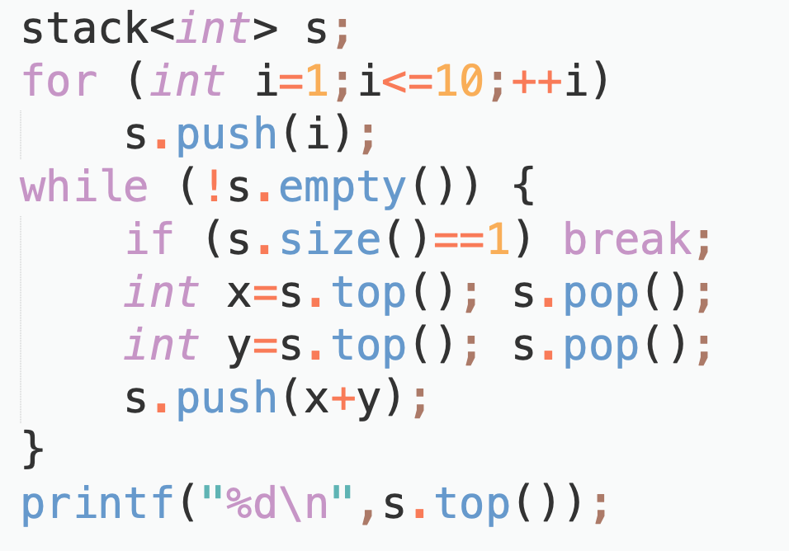
Stack code implementation ( STL )

Slide 22

Amazing stack
Numbers $1−N$ are pushed to the stack in the order $1,2,…,N$. By applying $N$ push operations and $N$ pop operations, how many possible permutations can be obtained? Which permutations are not among the popped sequences?

Slide 23
Parentheses matching
Given a legitimate sequence of parentheses containing only left and right parentheses, output the position of each pair of paired parentheses, in the order of the position of the right parenthesis, from left to right.

Slide 24
Reverse Polish Notation
Evaluation of Reverse Polish Notation (postfix notation)

Slide 25
stack operations
Execution and output of stack operations

Slide 26
Queues and applications
Note: Please turn off your microphone and camera.
Mr. Gao's Algorithm
Competition Training Camp

Slide 27
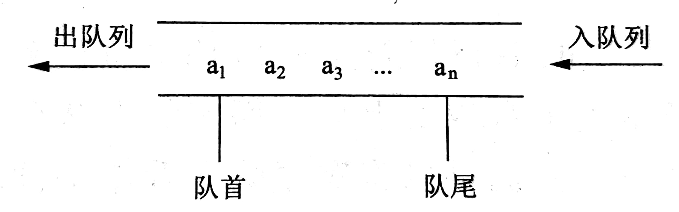
queues
Store elements that are not yet processed but need to be processed in a certain order.
First In First Out ( FIFO )
Main operations
is_empty, is_full, size
enqueue
dequeue
Implementation
Sequential list (array) q[m]
front pointer front
rear pointer rear
dequeue
enqueue
front
rear

Slide 28
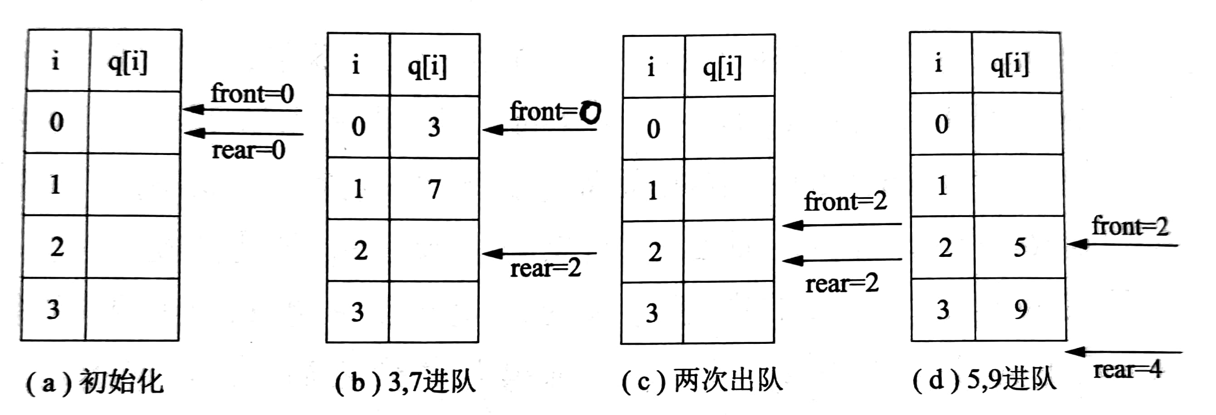
queue
initialise
enqueue 3,
enqueue 7
dequeue
twice
enqueue
5, 9

Slide 29
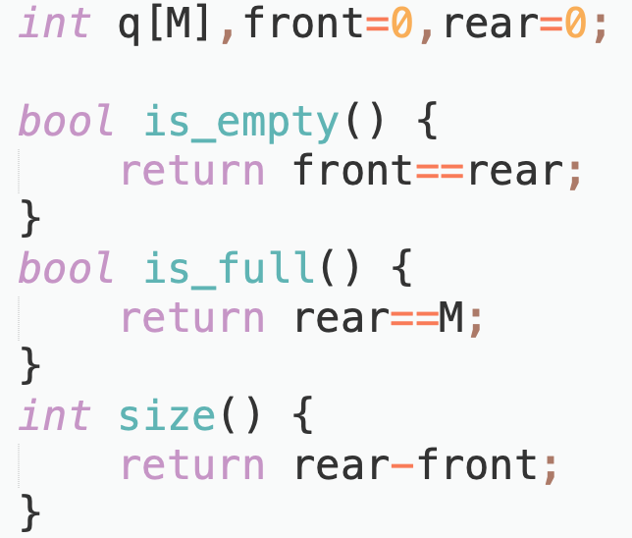
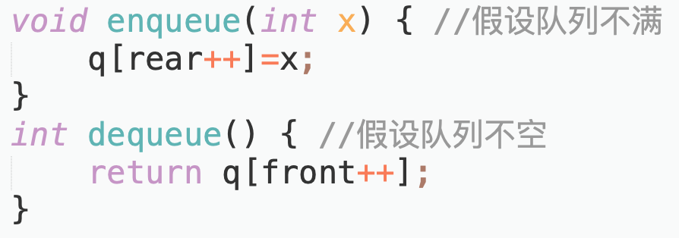
Queue code implementation
//Not full
//Not empty

Slide 30
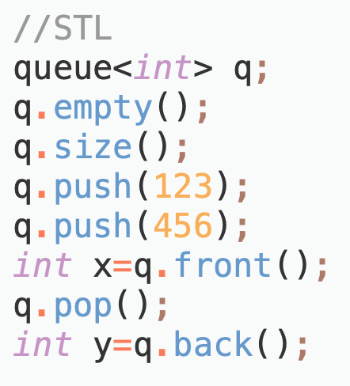
Queue code implementation ( STL )

Slide 31
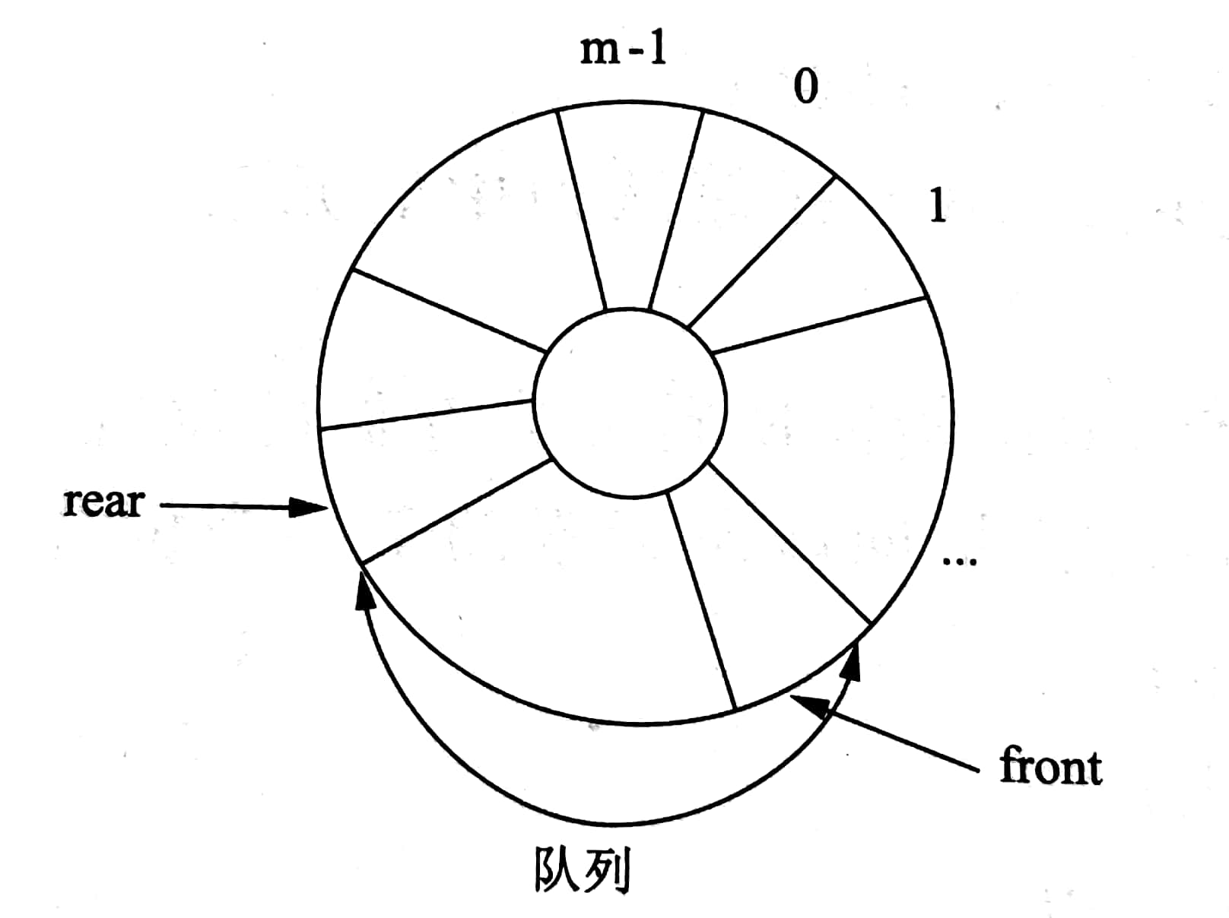

Circular queues
Make full use of array space and avoid waste.
Problem
$q\left[0\right]−q[front−1]$ is wasted.
Solution
When $rear==M$ let $rear=0$, reuse space
Pay attention
How to determine if a queue is full?
queue

Slide 32
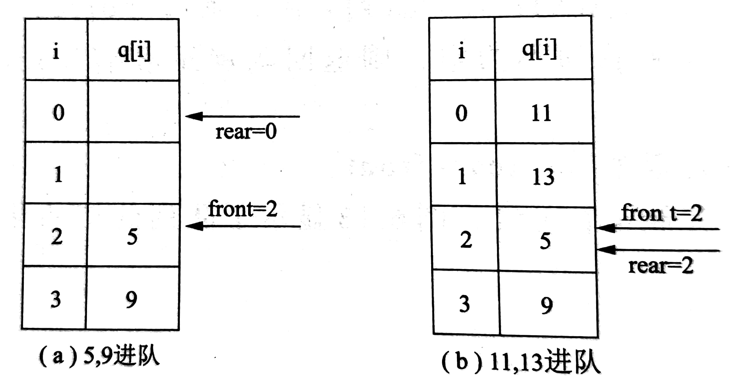
Circular queues
enqueue 5,
enqueue 9
enqueue 11,
enqueue 13

Slide 33
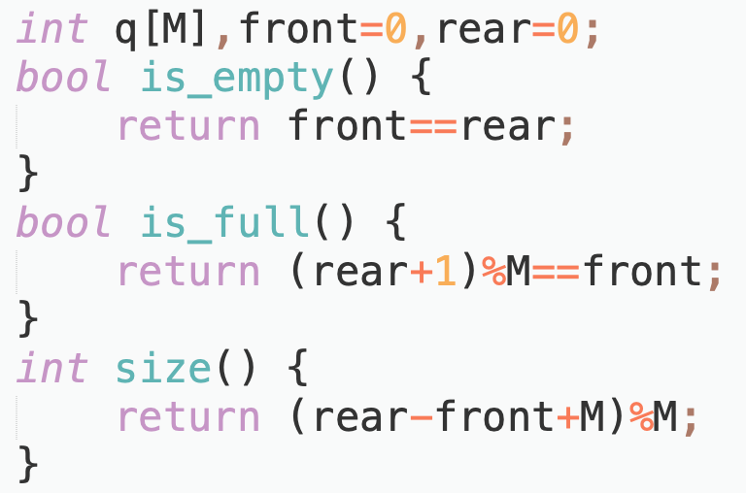
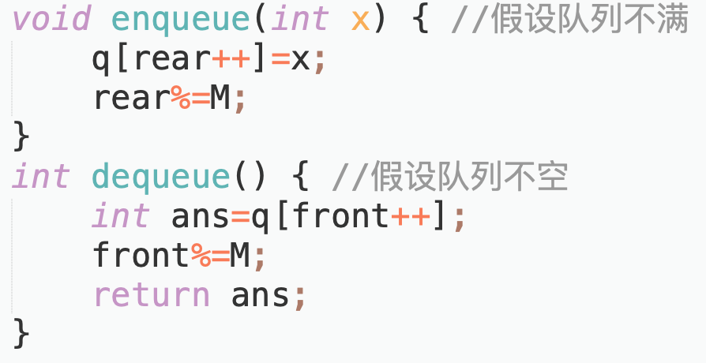
Code implementation of circular queues
//Not full
//Not empty

Slide 34

Connected components
Given a $N∗M$ grid, calculate the number of connected components.
$1≤N,M≤100$

Slide 35
Queue operations
Execute queue operations and output results

Slide 36
Queue Operations - 2
Execute queue operations and output results, must use circular queues.

Slide 37
Thank you everyone.
Note: Please turn off your microphone and camera.
Teacher Gao's Algorithm Competition Training Camp

